Slide 1
Addressing the Network – IPv4
Network Fundamentals – Chapter 6

Slide 2
Objectives
Explain the structure IP addressing and demonstrate the ability to convert between 8-bit binary and decimal numbers.
Given an IPv4 address, classify by type and describe how it is used in the network
Explain how addresses are assigned to networks by ISPs and within networks by administrators
Determine the network portion of the host address and explain the role of the subnet mask in dividing networks.
Given IPv4 addressing information and design criteria, calculate the appropriate addressing components.
Use common testing utilities to verify and test network connectivity and operational status of the IP protocol stack on a host.

Slide 3
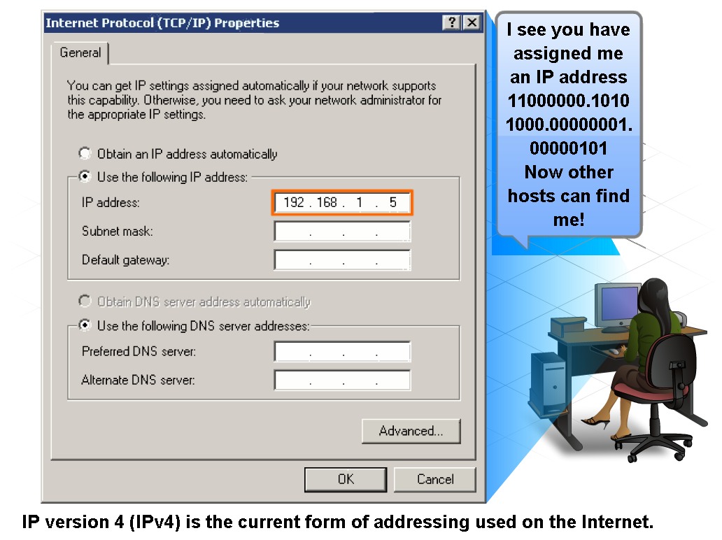
IP Addressing Structure
Describe the dotted decimal structure of a binary IP address and label its parts

Slide 4
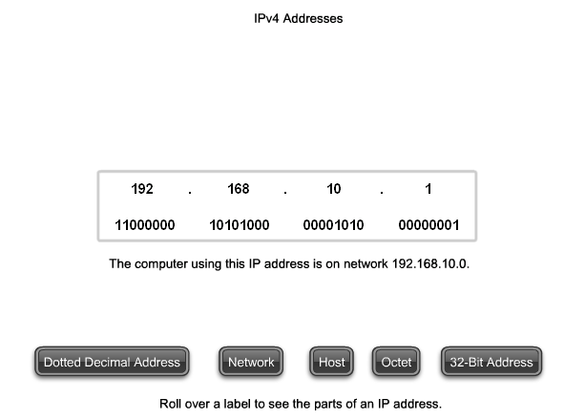
IP Addressing Structure
Describe the general role of 8-bit binary in network addressing and convert 8-bit binary to decimal

Slide 5
Dotted Decimal
Binary patterns representing IPv4 addresses are expressed as dotted decimals by separating each byte of the binary pattern, called an octet, with a dot.
It is called an octet because each decimal number represents one byte or 8 bits.
For example, the address:
10101100000100000000010000010100
is expressed in dotted decimal as:
172.16.4.20

Slide 6
Network and Host Portions
For each IPv4 address, some portion of the high-order bits represents the network address.
At Layer 3, we define a network as a group of hosts that have identical bit patterns in the network address portion of their addresses.
Although all 32 bits define the IPv4 host address, we have a variable number of bits that are called the host portion of the address.
The number of bits used in this host portion determines the number of hosts that we can have within the network.

Slide 7
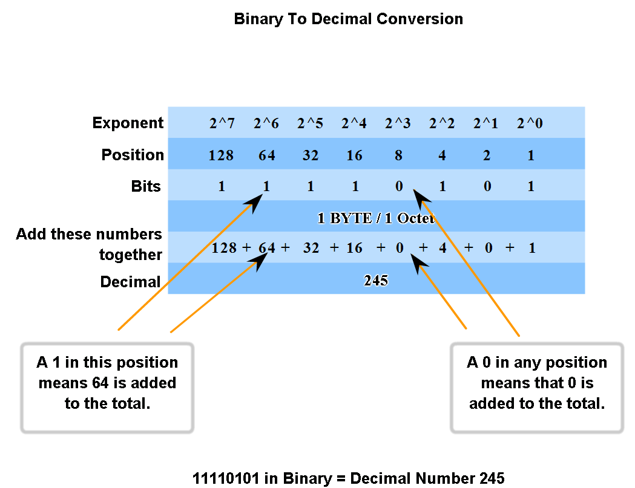
IP Addressing Structure
Practice converting 8-bit binary to decimal

Slide 8
Positional Notation
Learning to convert binary to decimal requires an understanding of the mathematical basis of a numbering system called positional notation.
Positional notation means that a digit represents different values depending on the position it occupies.
More specifically, the value that a digit represents is that value multiplied by the power of the base, or radix, represented by the position the digit occupies.
Some examples will help to clarify how this system works.

Slide 9
Example with Decimal
For the decimal number 245, the value that the 2 represents is 2*10^2 (2 times 10 to the power of 2).
The 2 is in what we commonly refer to as the "100s" position. Positional notation refers to this position as the base^2 position because the base, or radix, is 10 and the power is 2.
Using positional notation in the base 10 number system, 245 represents:
245 = (2 * 10^2) + (4 * 10^1) + (5 * 10^0)
or
245 = (2 * 100) + (4 * 10) + (5 * 1)

Slide 10
Binary Numbering System
In the binary numbering system, the radix is 2. Therefore, each position represents increasing powers of 2. In 8-bit binary numbers, the positions represent these quantities:
2^7 2^6 2^5 2^4 2^3 2^2 2^1 2^0
128 64 32 16 8 4 2 1
The base 2 numbering system only has two digits: 0 and 1.
When we interpret a byte as a decimal number, we have the quantity that position represents if the digit is a 1 and we do not have that quantity if the digit is a 0

Slide 11
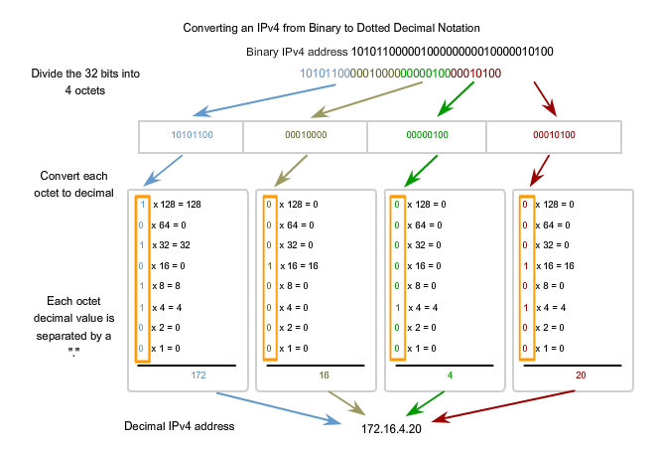
Converting Binary to Decimal

Slide 12
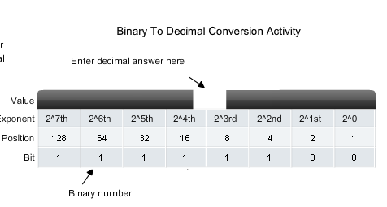
Exercise

Slide 13
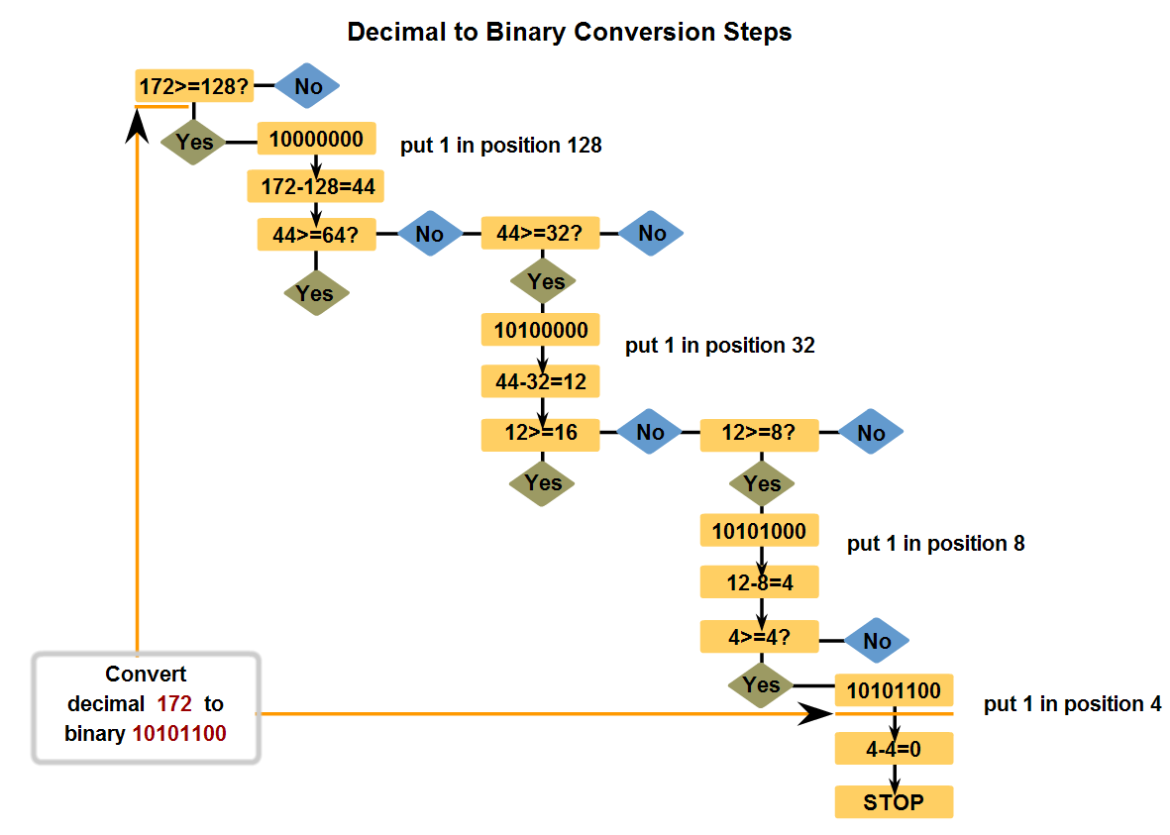
IP Addressing Structure
Convert decimal to 8-bit binary

Slide 14
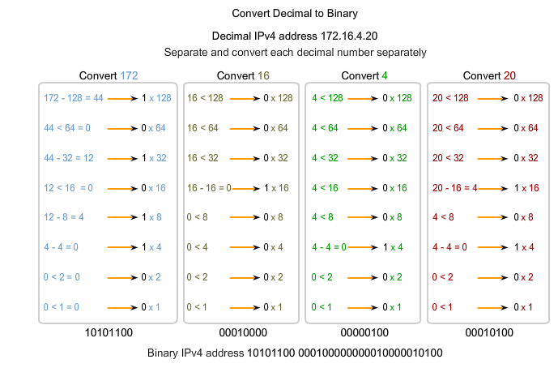
Converting Example

Slide 15
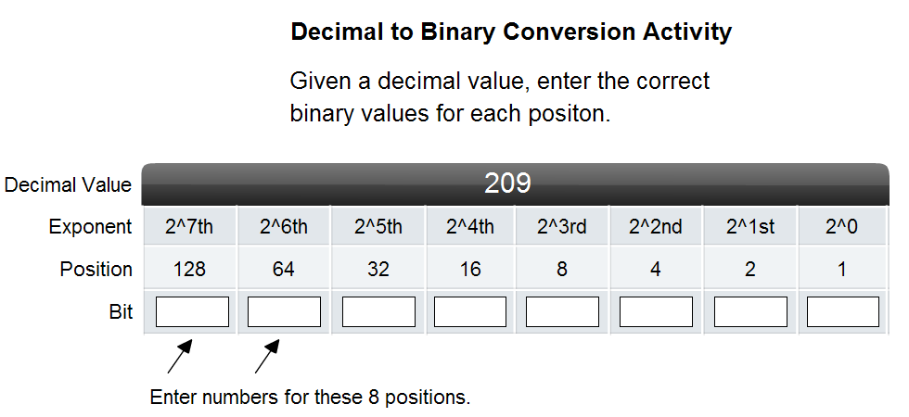
IP Addressing Structure
Practice converting decimal to 8-bit binary

Slide 16
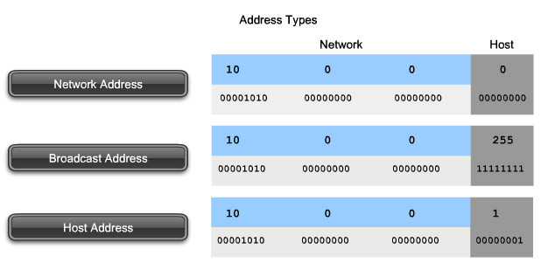
Classify and Define IPv4 Addresses
Name the three types of addresses in the network and describe the purpose of each type

Slide 17
Network Address
The network address is a standard way to refer to a network. For example, we could refer to the network shown in the figure as "the 10.0.0.0 network."
This is a much more convenient and descriptive way to refer to the network than using a term like "the first network."
All hosts in the 10.0.0.0 network will have the same network bits.
Within the IPv4 address range of a network, the lowest address is reserved for the network address.
This address has a 0 for each host bit in the host portion of the address.

Slide 18
Broadcast Address
The IPv4 broadcast address is a special address for each network that allows communication to all the hosts in that network.
To send data to all hosts in a network, a host can send a single packet that is addressed to the broadcast address of the network.
The broadcast address uses the highest address in the network range. This is the address in which the bits in the host portion are all 1s.
For the network 10.0.0.0 with 24 network bits, the broadcast address would be 10.0.0.255. This address is also referred to as the directed broadcast.
As described previously, every end device requires a unique address to deliver a packet to that host.
In IPv4 addresses, we assign the values between the network address and the broadcast address to the devices in that network.

Slide 19
Network Prefixes
An important question is: How do we know how many bits represent the network portion and how many bits represent the host portion?
When we express an IPv4 network address, we add a prefix length to the network address.
The prefix length is the number of bits in the address that gives us the network portion.
For example, in 172.16.4.0 /24, the /24 is the prefix length - it tells us that the first 24 bits are the network address.
This leaves the remaining 8 bits, the last octet, as the host portion.
The subnet mask consists of 32 bits, just as the address does, and uses 1s and 0s to indicate which bits of the address are network bits and which bits are host bits.

Slide 20
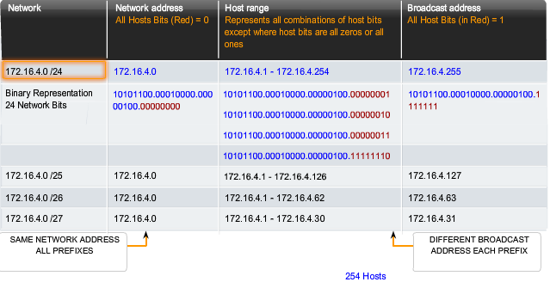
Example of Prefix

Slide 21
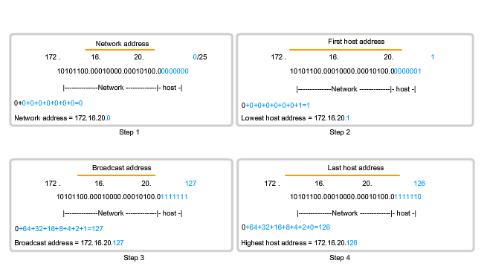
Another Example

Slide 22
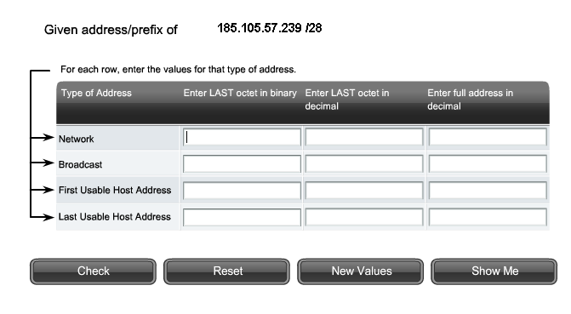
Classify and Define IPv4 Addresses
Determine the network, broadcast and host addresses for a given address and prefix combination

Slide 23
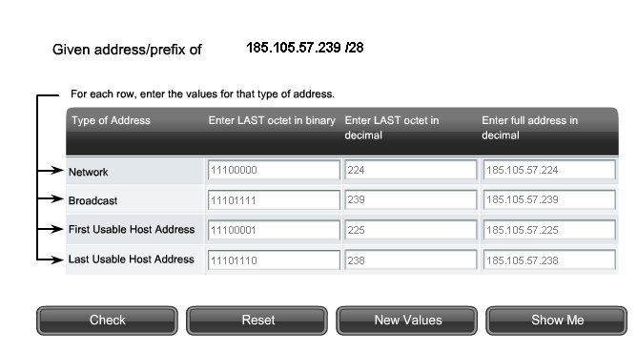
Example with Answers

Slide 24
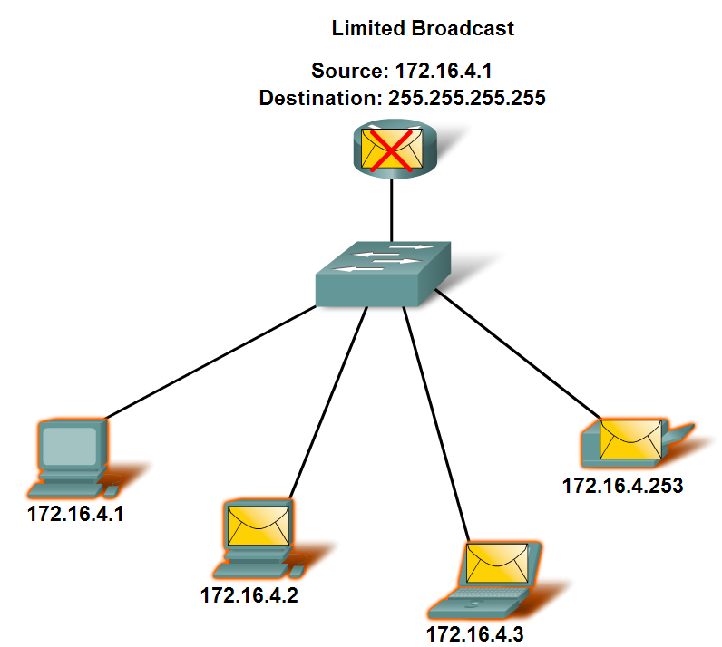
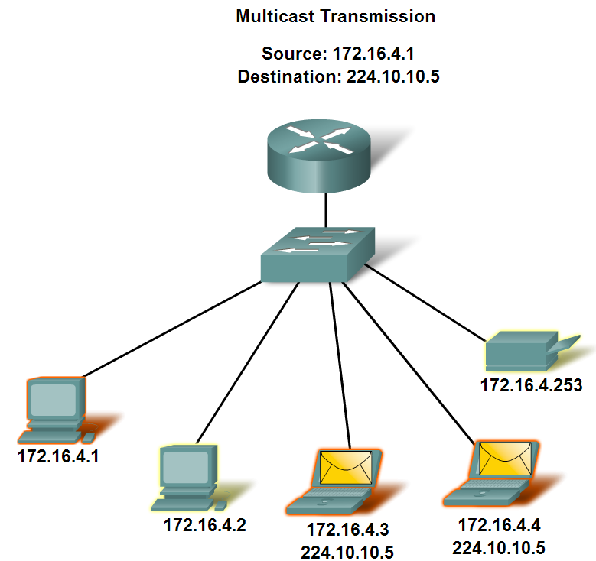
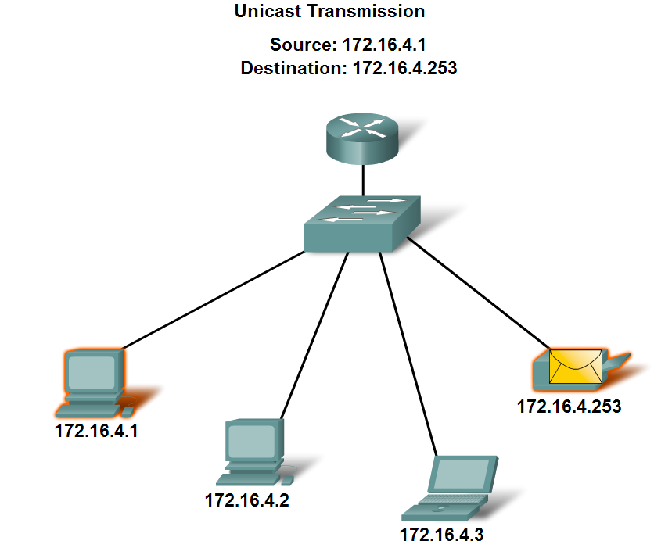
Classify and Define IPv4 Addresses
Name the three types of communication in the Network Layer and describe the characteristics of each type

Slide 25
Three Ways of Communicating
In an IPv4 network, the hosts can communicate one of three different ways:
Unicast - the process of sending a packet from one host to an individual host
Broadcast - the process of sending a packet from one host to all hosts in the network
Multicast - the process of sending a packet from one host to a selected group of hosts
These three types of communication are used for different purposes in the data networks. In all three cases, the IPv4 address of the originating host is placed in the packet header as the source address.

Slide 26
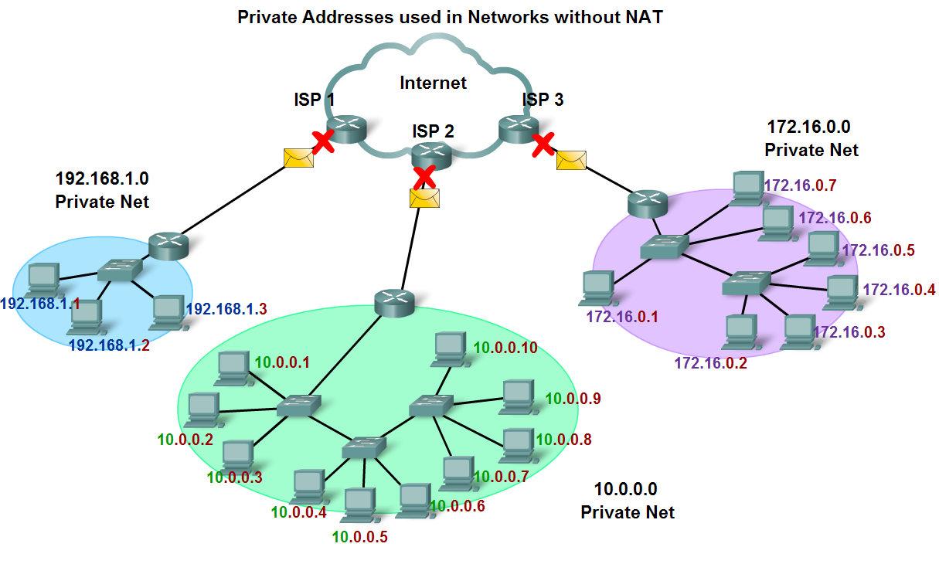
Classify and Define IPv4 Addresses
Define public address and private address

Slide 27
Private Addressing
The private address blocks are:
10.0.0.0 to 10.255.255.255 (10.0.0.0 /8)
172.16.0.0 to 172.31.255.255 (172.16.0.0 /12)
192.168.0.0 to 192.168.255.255 (192.168.0.0 /16)
Private space address blocks, as shown in the figure, are set aside for use in private networks.
The use of these addresses need not be unique among outside networks.
Hosts that do not require access to the Internet at large may make unrestricted use of private addresses.
However, the internal networks still must design network address schemes to ensure that the hosts in the private networks use IP addresses that are unique within their networking environment.

Slide 28
NAT – Network Address Translation
With services to translate private addresses to public addresses, hosts on a privately addressed network can have access to resources across the Internet.
These services, called Network Address Translation (NAT), can be implemented on a device at the edge of the private network.
NAT allows the hosts in the network to "borrow" a public address for communicating to outside networks.
While there are some limitations and performance issues with NAT, clients for most applications can access services over the Internet without noticeable problems.

Slide 29
Special Addresses
Network and Broadcast Addresses
As explained earlier, within each network the first and last addresses cannot be assigned to hosts. These are the network address and the broadcast address, respectively.
Default Route
Also presented earlier, we represent the IPv4 default route as 0.0.0.0.
The default route is used as a "catch all" route when a more specific route is not available. The use of this address also reserves all addresses in the 0.0.0.0 - 0.255.255.255 (0.0.0.0 /8) address block.

Slide 30
Loopback Address
One such reserved address is the IPv4 loopback address 127.0.0.1.
The loopback is a special address that hosts use to direct traffic to themselves.
The loopback address creates a shortcut method for TCP/IP applications and services that run on the same device to communicate with one another.
By using the loopback address instead of the assigned IPv4 host address, two services on the same host can bypass the lower layers of the TCP/IP stack.
You can also ping the loopback address to test the configuration of TCP/IP on the local host.

Slide 31
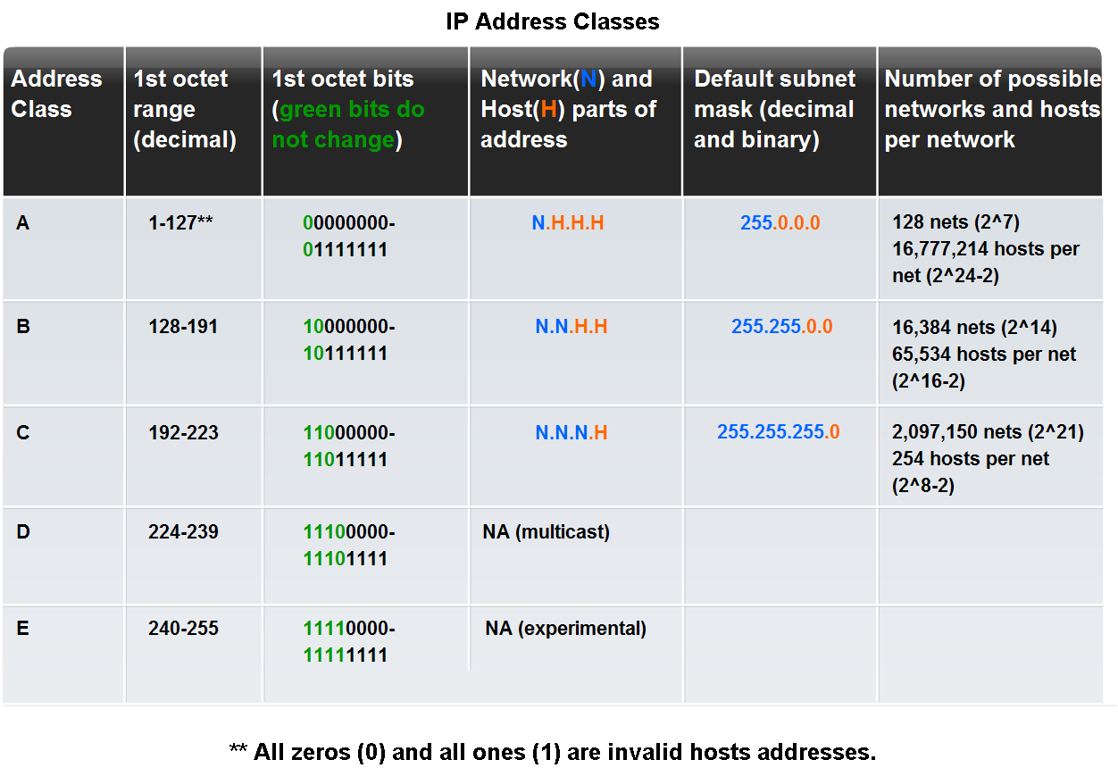
Classify and Define IPv4 Addresses
Identify the historic method for assigning addresses and the issues associated with the method

Slide 32
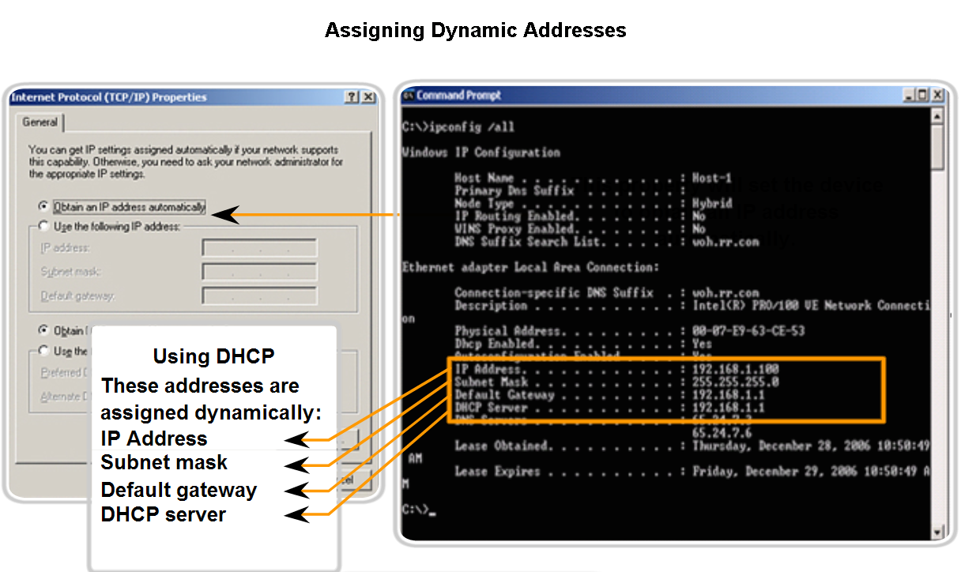
Assigning Addresses
Explain how end user devices can obtain addresses either statically through an administrator or dynamically through DHCP

Slide 33
Static Assignment
With a static assignment, the network administrator must manually configure the network information for a host, as shown in the figure. At a minimum, this includes entering the host IP address, subnet mask, and default gateway.
Static addresses have some advantages over dynamic addresses.
For instance, they are useful for printers, servers, and other networking devices that need to be accessible to clients on the network.
If hosts normally access a server at a particular IP address, it would cause problems if that address changed.
Additionally, static assignment of addressing information can provide increased control of network resources. However, it can be time-consuming to enter the information on each host.
When using static IP addressing, it is necessary to maintain an accurate list of the IP address assigned to each device. These are permanent addresses and are not normally reused.

Slide 34
Dynamic Assignment
DHCP enables the automatic assignment of addressing information such as IP address, subnet mask, default gateway, and other configuration information.
The configuration of the DHCP server requires that a block of addresses, called an address pool, be defined to be assigned to the DHCP clients on a network.
Addresses assigned to this pool should be planned so that they exclude any addresses used for the other types of devices.
DHCP is generally the preferred method of assigning IP addresses to hosts on large networks because it reduces the burden on network support staff and virtually eliminates entry errors.
Another benefit of DHCP is that an address is not permanently assigned to a host but is only "leased" for a period of time.

Slide 35
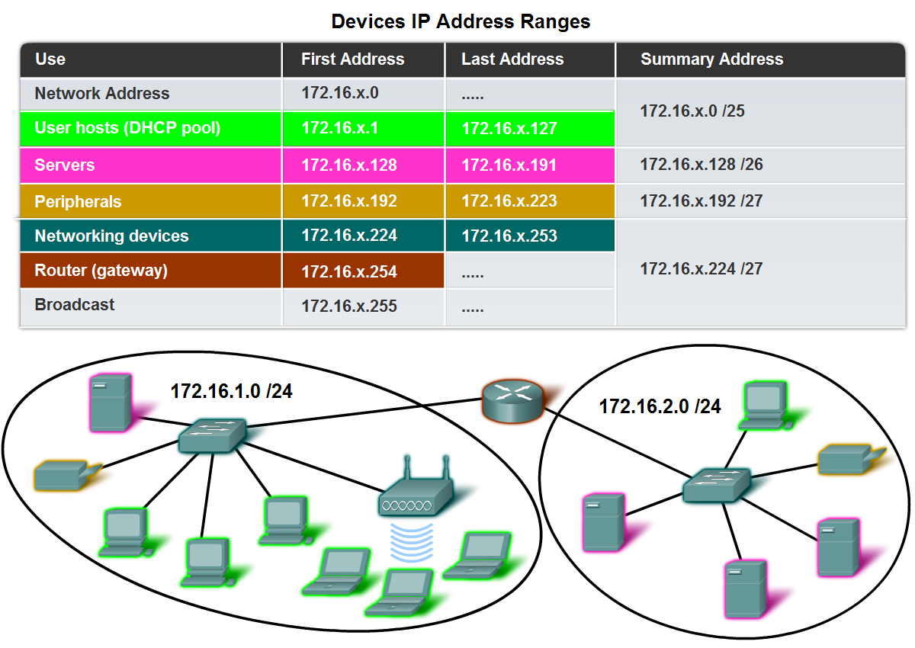
Assigning Addresses
Explain which types of addresses should be assigned to devices other than end user devices

Slide 36
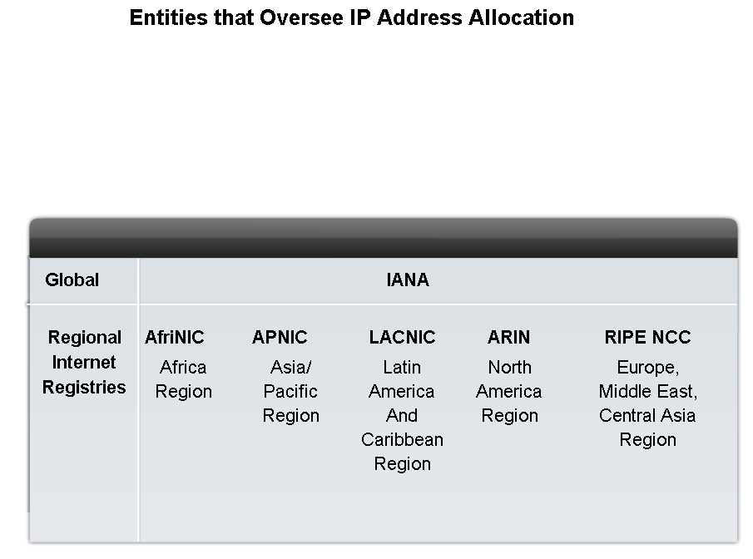
Assigning Addresses
Describe the process for requesting IPv4 public addresses, the role ISPs play in the process, and the role of the regional agencies that manage IP address registries

Slide 37
IANA – for IP Addresses
Internet Assigned Numbers Authority (IANA) (http://www.iana.net) is the master holder of the IP addresses.
The IP multicast addresses are obtained directly from IANA. Until the mid-1990s, all IPv4 address space was managed directly by the IANA.
At that time, the remaining IPv4 address space was allocated to various other registries to manage for particular purposes or for regional areas.
These registration companies are called Regional Internet Registries (RIRs), as shown in the figure.
When a RIR requires more IP addresses for allocation or assignment within its region, the IANA allocates IPv6 addresses to the RIRs according to their established needs.

Slide 38
Major Registries
The major registries are:
AfriNIC (African Network Information Centre) - Africa Region http://www.afrinic.net
APNIC (Asia Pacific Network Information Centre) - Asia/Pacific Region http://www.apnic.net
ARIN (American Registry for Internet Numbers) - North America Region http://www.arin.net
LACNIC (Regional Latin-American and Caribbean IP Address Registry) - Latin America and some Caribbean Islands http://www.lacnic.net
RIPE NCC (Reseaux IP Europeans) - Europe, the Middle East, and Central Asia http://www.ripe.net

Slide 39
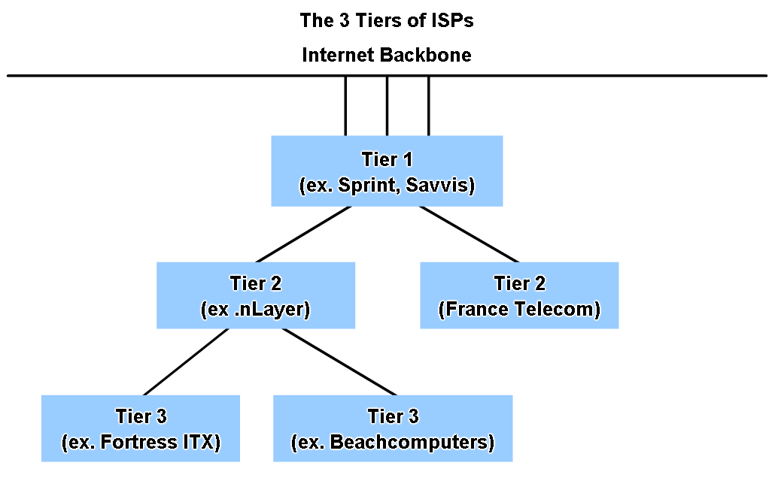
Assigning Addresses
Identify different types of ISPs and their roles in providing Internet connectivity

Slide 40
The Role of an ISP
Most companies or organizations obtain their IPv4 address blocks from an ISP.
An ISP will generally supply a small number of usable IPv4 addresses (6 or 14) to their customers as a part of their services.
Larger blocks of addresses can be obtained based on justification of needs and for additional service costs.
In a sense, the ISP loans or rents these addresses to the organization.
If we choose to move our Internet connectivity to another ISP, the new ISP will provide us with addresses from the address blocks that have been provided to them, and our previous ISP returns the blocks loaned to us to their allocation to be loaned to another customer.

Slide 41
ISP Services
To get access to the services of the Internet, we have to connect our data network to the Internet using an Internet Service Provider (ISP).
ISPs have their own set of internal data networks to manage Internet connectivity and to provide related services.
Among the other services that an ISP generally provides to its customers are DNS services, e-mail services, and a website.
Depending on the level of service required and available, customers use different tiers of an ISP.

Slide 42
Tier 1, 2 and 3
At the top of the ISP hierarchy are Tier 1 ISPs. These ISPs are large national or international ISPs that are directly connected to the Internet backbone.
The primary advantages for customers of Tier 1 ISPs are reliability and speed
Tier 2 ISPs acquire their Internet service from Tier 1 ISPs. Tier 2 ISPs generally focus on business customers.
The primary disadvantage of Tier 2 ISPs, as compared to Tier 1 ISPs, is slower Internet access.
Tier 3 ISPs purchase their Internet service from Tier 2 ISPs. The focus of these ISPs is the retail and home markets in a specific locale.

Slide 43
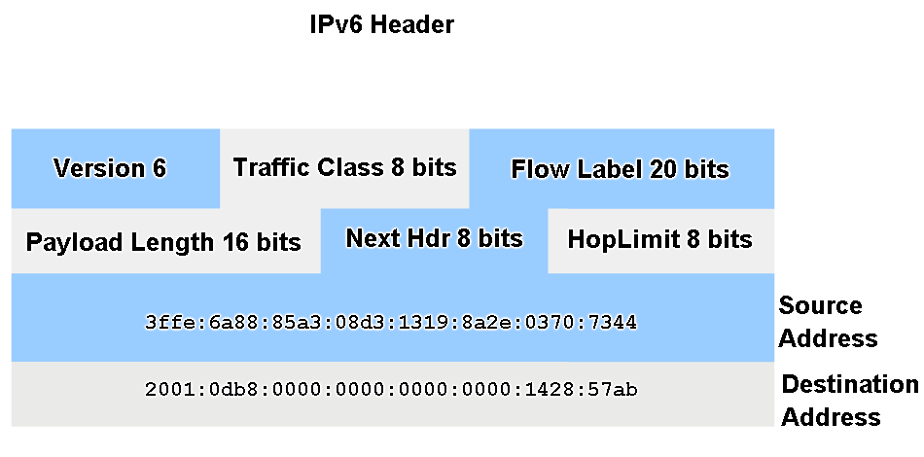
Assigning Addresses
Identify several changes made to the IP protocol in IPv6 and describe the motivation for migrating from IPv4 to IPv6.

Slide 44
IPv6 Overview
Creating expanded addressing capabilities was the initial motivation for developing this new protocol. Other issues were also considered during the development of IPv6, such as:
Improved packet handling
Increased scalability and longevity
QoS mechanisms
Integrated security
To provide these features, IPv6 offers:
128-bit hierarchical addressing - to expand addressing capabilities
Header format simplification - to improve packet handling
Improved support for extensions and options - for increased scalability/longevity and improved packet handling
Flow labeling capability - as QoS mechanisms
Authentication and privacy capabilities - to integrate security

Slide 45
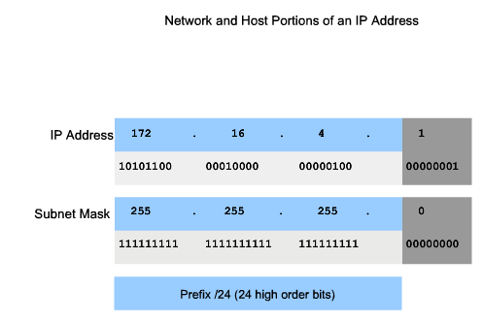
Determine the network portion of the host address and the role of the subnet mask
Describe how the subnet mask is used to create and specify the network and host portions of an IP address

Slide 46
Subnet Mask
To define the network and host portions of an address, the devices use a separate 32-bit pattern called a subnet mask, as shown in the figure.
We express the subnet mask in the same dotted decimal format as the IPv4 address.
The subnet mask is created by placing a binary 1 in each bit position that represents the network portion and placing a binary 0 in each bit position that represents the host portion.
The prefix and the subnet mask are different ways of representing the same thing - the network portion of an address.

Slide 47
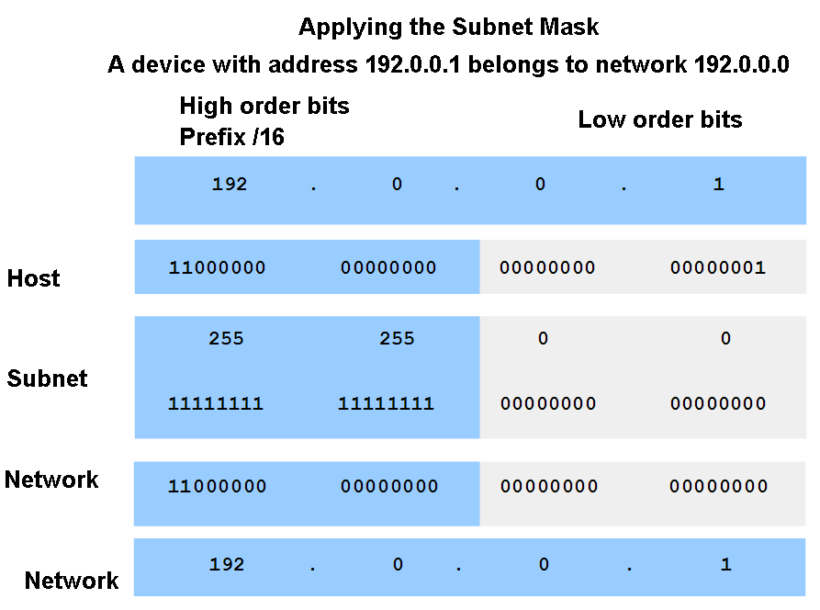
Determine the network portion of the host address and the role of the subnet mask
Use the subnet mask and ANDing process to extract the network address from the IP address.

Slide 48
ANDing
The IPv4 host address is logically ANDed with its subnet mask to determine the network address to which the host is associated.
When this ANDing between the address and the subnet mask is performed, the result yields the network address.
The AND Operation
ANDing is one of three basic binary operations used in digital logic.
The other two are OR and NOT. While all three are used in data networks, AND is used in determining the network address.

Slide 49
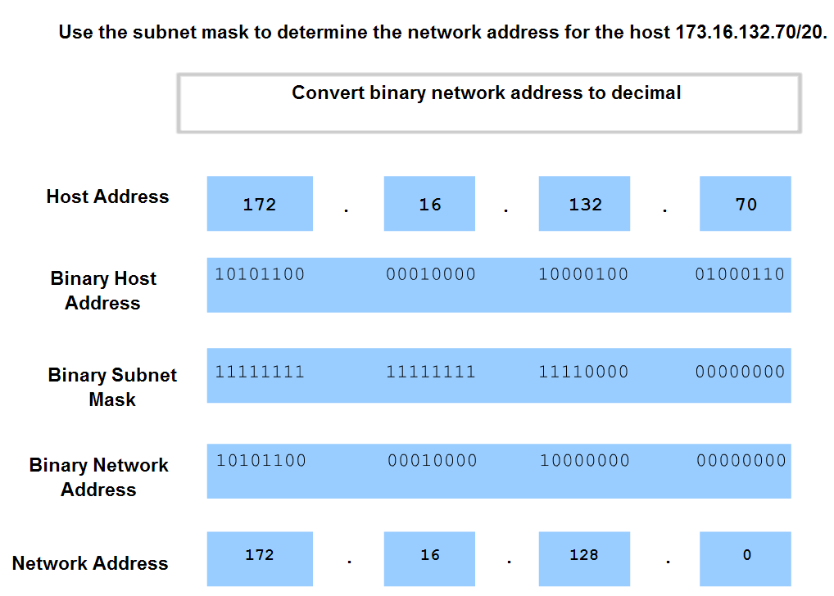
Determine the network portion of the host address and the role of the subnet mask
Observe the steps in the ANDing of an IPv4 host address and subnet mask

Slide 50
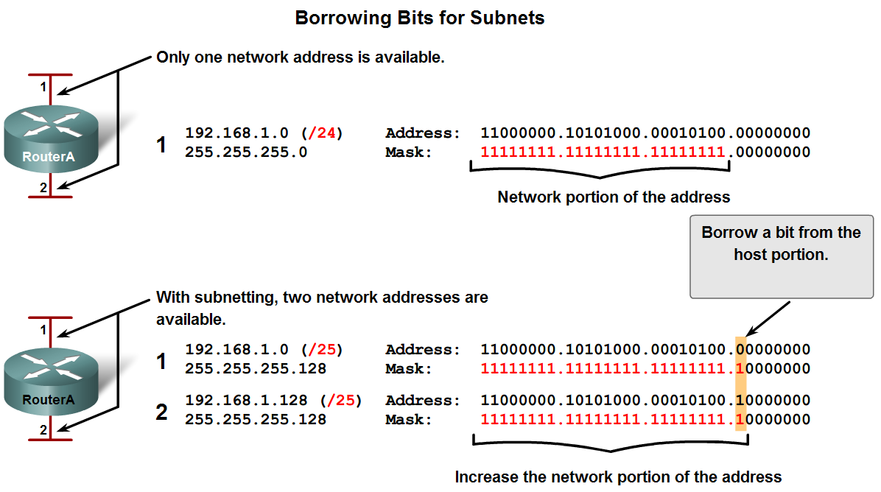
Calculating Addresses
Use the subnet mask to divide a network into smaller networks and describe the implications of dividing networks for network planners

Slide 51
Subnetting
Subnetting allows for creating multiple logical networks from a single address block.
Since we use a router to connect these networks together, each interface on a router must have a unique network ID. Every node on that link is on the same network.
We create the subnets by using one or more of the host bits as network bits.
This is done by extending the mask to borrow some of the bits from the host portion of the address to create additional network bits.
The more host bits used, the more subnets that can be defined. For each bit borrowed, we double the number of subnetworks available.
For example, if we borrow 1 bit, we can define 2 subnets. If we borrow 2 bits, we can have 4 subnets. However, with each bit we borrow, fewer host addresses are available per subnet.

Slide 52
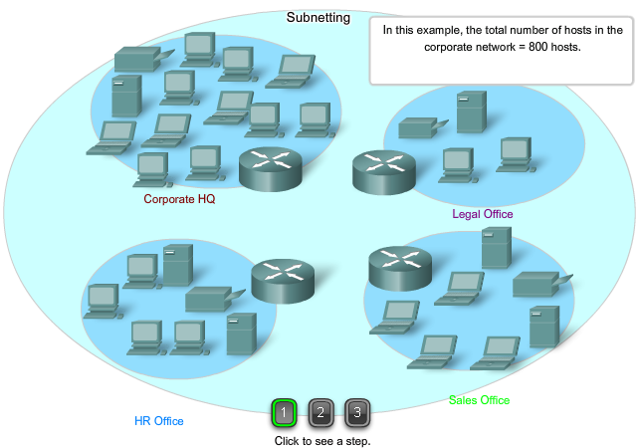
Step 1 – Determine the number and size of the network

Slide 53
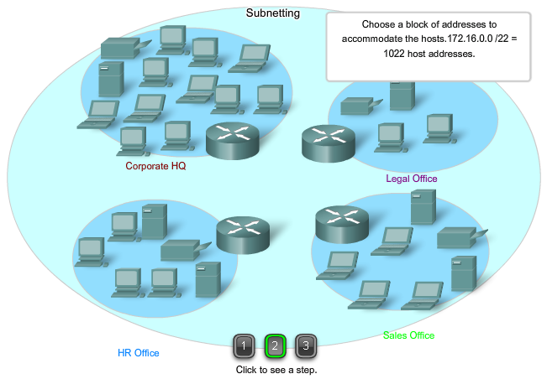
Step 2 – Comprise a Single Block of Addresses

Slide 54
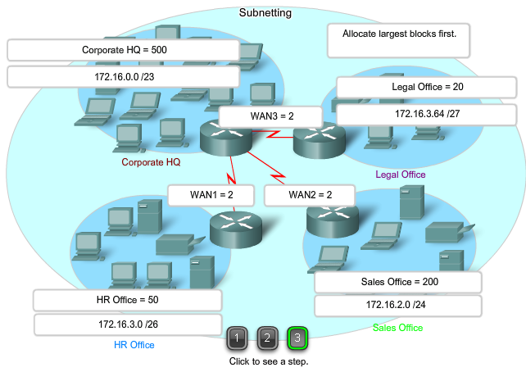
Step 3 – Allocate the Addresses

Slide 55
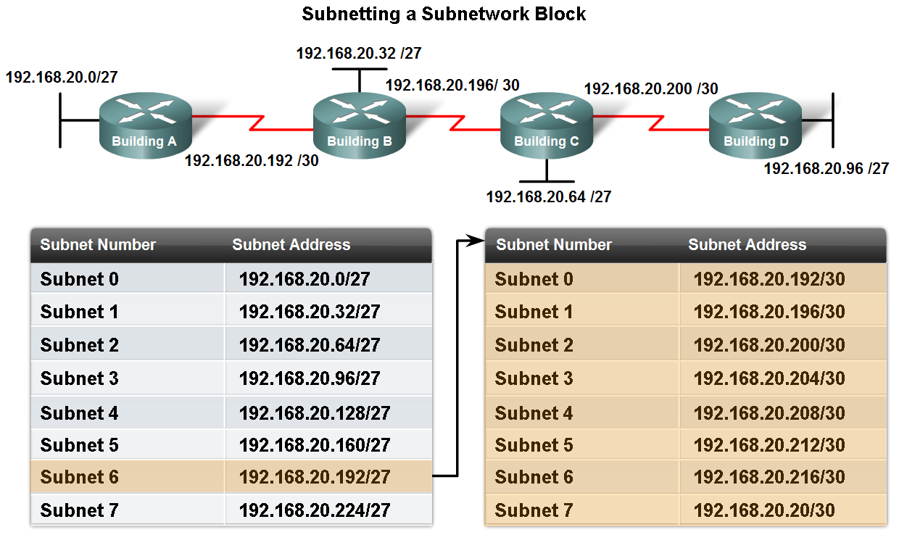
Calculating Addresses
Calculate the number of hosts in a network range given an address and subnet mask

Slide 56
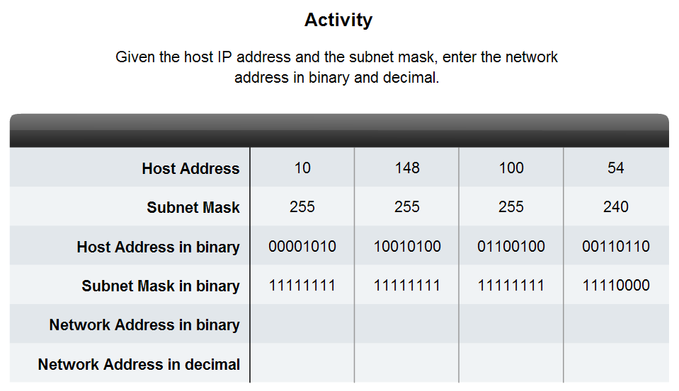
Calculating Addresses
Given a subnet address and subnet mask, calculate the network address, host addresses and broadcast address

Slide 57
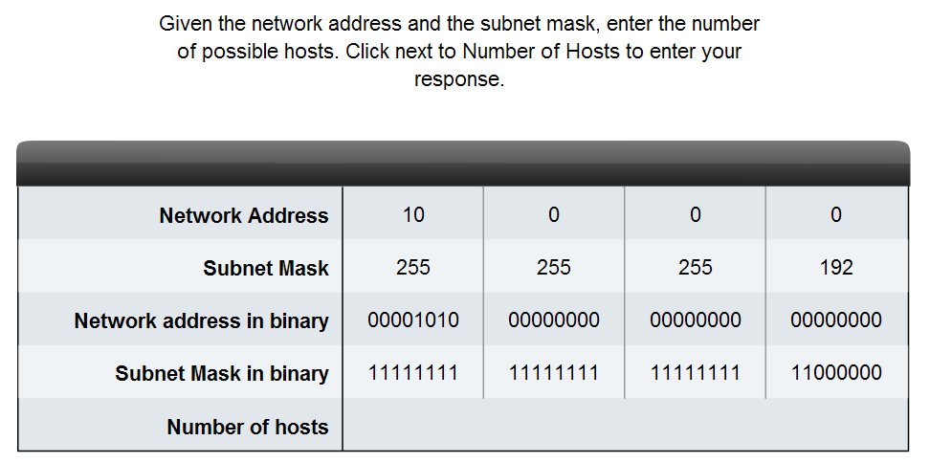
Calculating Addresses
Given a pool of addresses and masks, assign a host parameter with address, mask and gateway

Slide 58
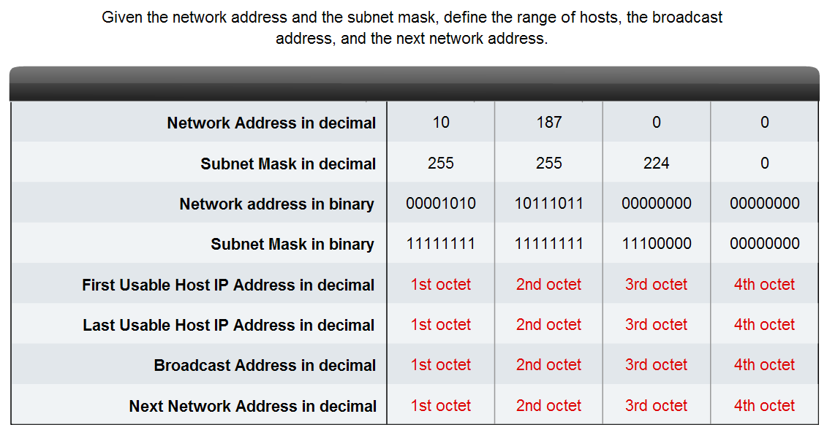
Calculating Addresses
Given a diagram of a multi-layered network, address range, number of hosts in each network and the ranges for each network, create a network scheme that assigns addressing ranges to each network

Slide 59
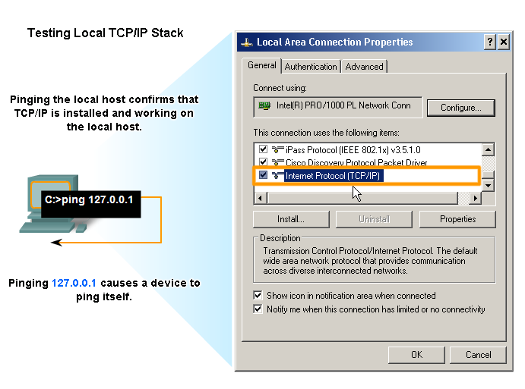
Testing the Network Layer
Describe the general purpose of the ping command, trace the steps of its operation in a network, and use the ping command to determine if the IP protocol is operational on a local host

Slide 60
PING – Packet InterNetwork Groper
Ping is a utility for testing IP connectivity between hosts. Ping sends out requests for responses from a specified host address.
Ping uses a Layer 3 protocol that is a part on the TCP/IP suite called Internet Control Message Protocol (ICMP). Ping uses an ICMP Echo Request datagram.
If the host at the specified address receives the Echo request, it responds with an ICMP Echo Reply datagram.
For each packet sent, ping measures the time required for the reply.
As each response is received, ping provides a display of the time between the ping being sent and the response received.
This is a measure of the network performance. Ping has a timeout value for the response. If a response is not received within that timeout, ping gives up and provides a message indicating that a response was not received.

Slide 61
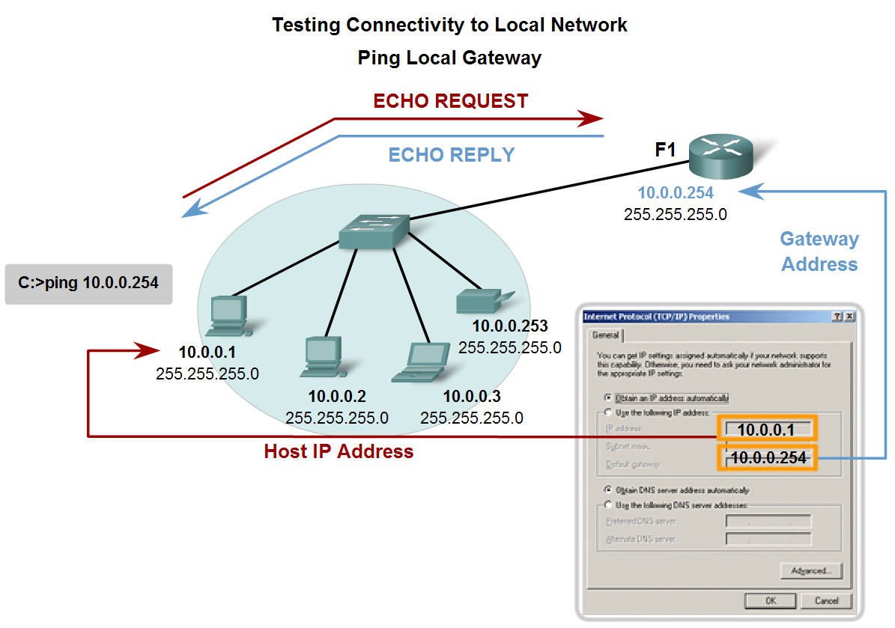
Testing the Network Layer
Use ping to verify that a local host can communicate with a gateway across a local area network

Slide 62
Testing the Gateway
You can also use ping to test the host ability to communicate on the local network.
This is generally done by pinging the IP address of the gateway of the host, as shown in the figure.
A ping to the gateway indicates that the host and the router's interface serving as that gateway are both operational on the local network.
For this test, the gateway address is most often used, because the router is normally always operational. If the gateway address does not respond, you can try the
IP address of another host that you are confident is operational in the local network.

Slide 63
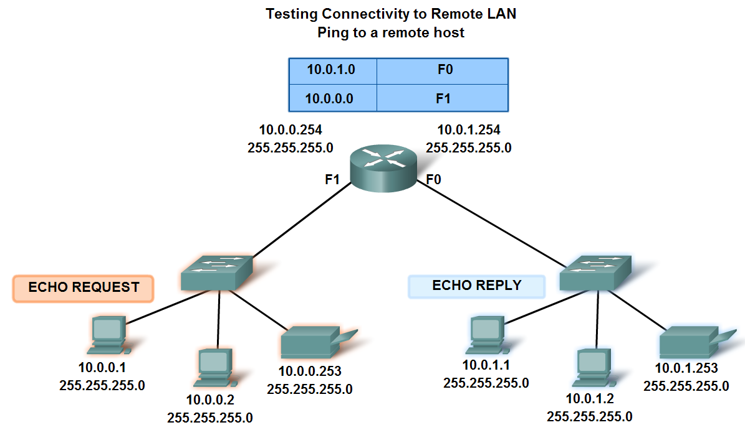
Testing the Network Layer
Use ping to verify that a local host can communicate via a gateway to a device in remote network

Slide 64
Testing the Network
Ping is used to indicate the connectivity between two hosts. Traceroute (tracert) is a utility that allows us to observe the path between these hosts.
The trace generates a list of hops that were successfully reached along the path.
This list can provide us with important verification and troubleshooting information. If the data reaches the destination, then the trace lists the interface on every router in the path.
If the data fails at some hop along the way, we have the address of the last router that responded to the trace.
This is an indication of where the problem or security restrictions are.

Slide 65
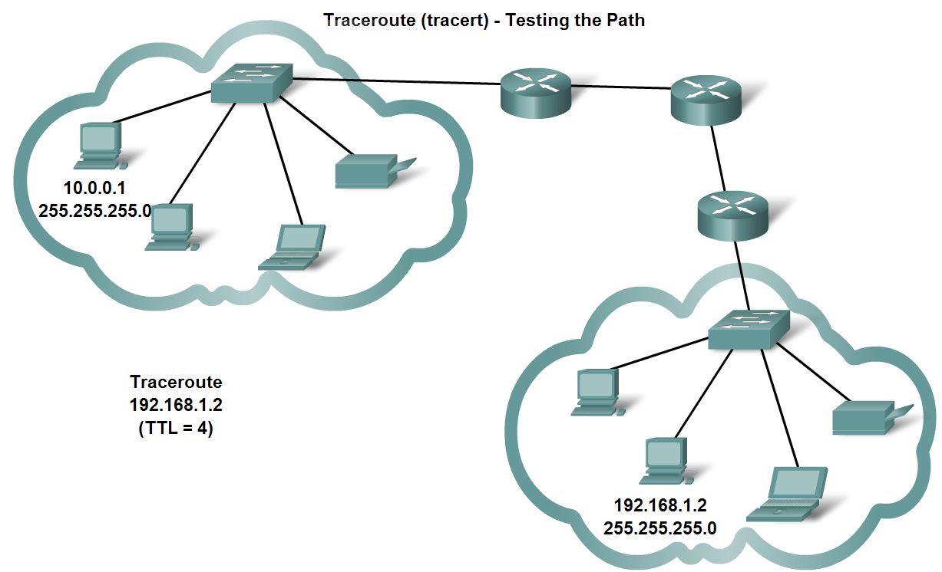
Testing the Network Layer
Use tracert/traceroute to observe the path between two devices as they communicate and trace the steps of tracert/traceroute's operation

Slide 66
RTT – Round Trip Time
Using traceroute provides round trip time (RTT) for each hop along the path and indicates if a hop fails to respond.
The round trip time (RTT) is the time a packet takes to reach the remote host and for the response from the host to return. An asterisk (*) is used to indicate a lost packet.
This information can be used to locate a problematic router in the path.
If we get high response times or data losses from a particular hop, this is an indication that the resources of the router or its connections may be stressed.

Slide 67
TTL – Time to Live
Traceroute makes use of a function of the Time to Live (TTL) field in the Layer 3 header and ICMP Time Exceeded Message.
The TTL field is used to limit the number of hops that a packet can cross. When a packet enters a router, the TTL field is decremented by 1.
When the TTL reaches zero, a router will not forward the packet and the packet is dropped.
In addition to dropping the packet, the router normally sends an ICMP Time Exceeded message addressed to the originating host. This ICMP message will contain the IP address of the router that responded.

Slide 68
ICMP
ICMP is the messaging protocol for the TCP/IP suite. ICMP provides control and error messages and is used by the ping and traceroute utilities.
Although ICMP uses the basic support of IP as if it were a higher-level protocol ICMP, it is actually a separate Layer 3 of the TCP/IP suite.
The types of ICMP messages - and the reasons why they are sent - are extensive. We will discuss some of the more common messages.
ICMP messages that may be sent include:
Host confirmation
Unreachable Destination or Service
Time exceeded
Route redirection
Source quench

Slide 69
1. Host Confirmation
An ICMP Echo Message can be used to determine if a host is operational.
The local host sends an ICMP Echo Request to a host. The host receiving the echo message replies with the ICMP Echo Reply, as shown in the figure.
This use of the ICMP Echo messages is the basis of the ping utility.

Slide 70
2. Unreachable Destination
The ICMP Destination Unreachable can used to notify a host that the destination or service is unreachable.
When a host or gateway receives a packet that it cannot deliver, it may send an ICMP Destination Unreachable packet to the host originating the packet.
The Destination Unreachable packet will contain codes that indicate why the packet could not be delivered.
Among the Destination Unreachable codes are:
0 = net unreachable
1 = host unreachable
2 = protocol unreachable
3 = port unreachable

Slide 71
3. Time Exceeded
An ICMP Time Exceeded message is used by a router to indicate that a packet cannot be forwarded because the TTL field of the packet has expired.
If a router receives a packet and decrements the TTL field in the packet to zero, it discards the packet.
The router may also send an ICMP Time Exceeded message to the source host to inform the host of the reason the packet was dropped.

Slide 72
4. Route Redirection
A router may use the ICMP Redirect Message to notify the hosts on a network that a better route is available for a particular destination.
This message may only be used when the source host is on the same physical network as both gateways.
If a router receives a packet for which it has a route and for which the next hop is attached to the same interface as the packet arrived, the router may send an ICMP Redirect Message to the source host.
This message will inform the source host of the next hop contained in a route in the routing table.

Slide 73
5. Source Quench
The ICMP Source Quench message can be used to tell the source to temporarily stop sending packets.
If a router does not have enough buffer space to receive incoming packets, a router will discard the packets.
If the router has to do so, it may also send an ICMP Source Quench message to source hosts for every message that it discards.
A destination host may also send a source quench message if datagrams arrive too fast to be processed.
When a host receives an ICMP Source Quench message, it reports it to the Transport layer. The source host can then use the TCP flow control mechanisms to adjust the transmission.

Slide 74
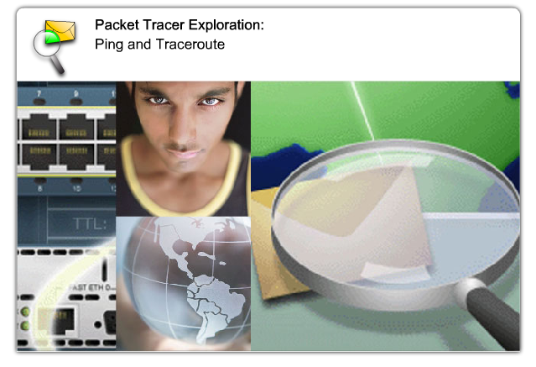
Labs – Packet Tracer

Slide 75
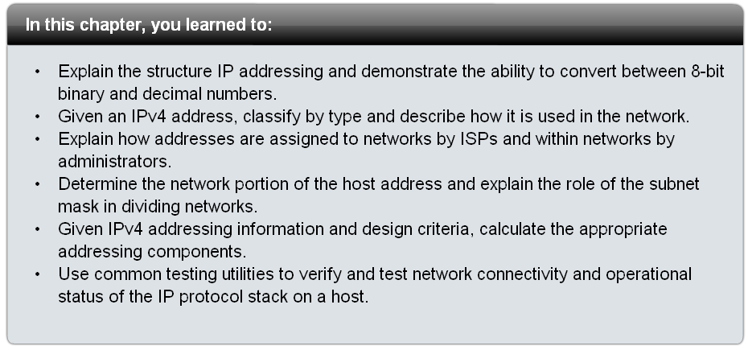
Summary

